Slide 1
Everyone has an opportunity to bless every day
30 January, 2018
Notes:
No two days are the same
Yet they are similar in some ways
One thing for sure is every day is a day to bless.
Even God has it on His to do list.
Psalm 68:19 tells us that He loads us with benefits everyday

Slide 2
Acts 2:35
Remember the words of the Lord Jesus, how he said, ‘It is more blessed [happier] to give than to receive.’
Notes:
Blessing others is a happy thing – not just for them but for us who are privileged to bless

Slide 3
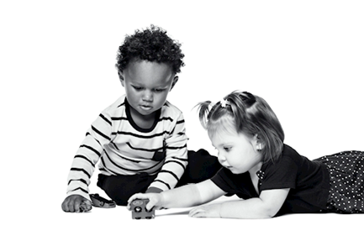
To bless is…
to bestow good of any kind upon
someone

Slide 4
I was…
Lonely
Confused
Needy
Notes:
My parents took me to Nigeria when they moved back to their home
It was safe and familiar
I had what I needed
I had family and friends
I moved back to UK in 1995
I was
Lonely
Confused
Needy

Slide 5
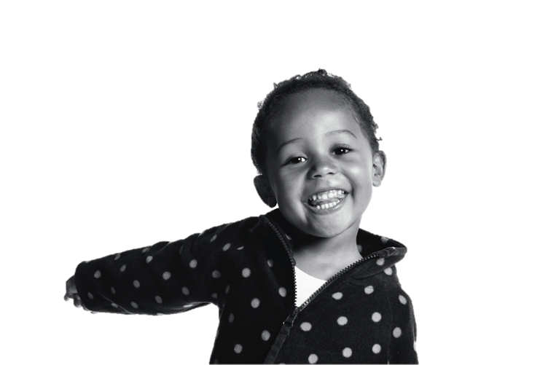
But, help came…
All these blessed me,
making me happy
Notes:
But help came… My friend Esther
Love
A helping hand
Money
Time
Voice
Kind words

Slide 6
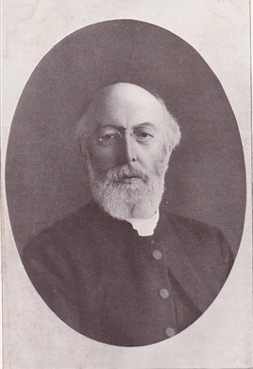
In 1869…
Rev Thomas Bowman Stephenson
Methodist minister &
founder, National Children’s Home
Notes:
In 1869, Our founder Rev Stephenson reached out to bless.
He set up a children’s home, which today still blesses.
Next slide..
At action for Children

Slide 7
The blessing continues daily…
370,000 children and families
Disabled children
Young unemployed
Children placed in safe, loving homes
Over 600 children’s services
Notes:
From blessing two young boys – the first ones to come into the care of Action for Children as it was then to blessing thousands
370,000 children and families
Disabled children
Young and unemployed
Children placed in safe loving homes
Over 600 children’s services

Slide 8
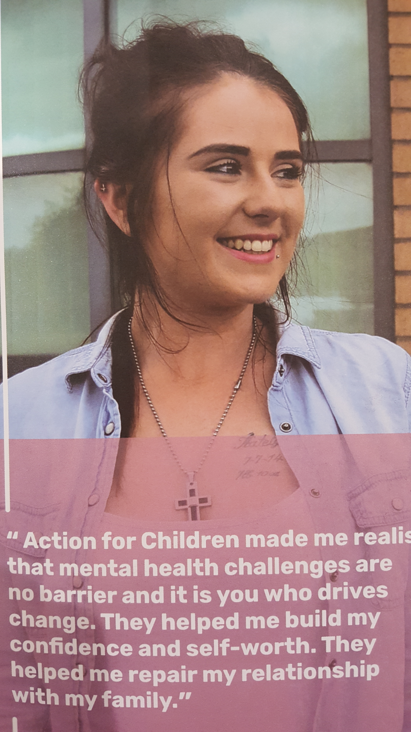
Grainne’s story

Slide 9
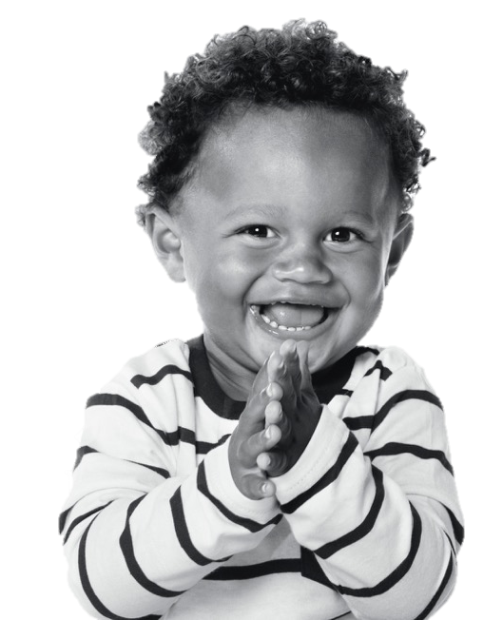
You too can be a blessing to someone
Pray
Say something nice
Spend time with someone
Volunteer for a good cause
Smile!
Notes:
Next slide - Raise money for charity – show them the lent resources

Slide 10
Twitter: @actnforchildren
Facebook: @actionforchildren
Instagram: @actionforchildrenUK
actionforchildren.org.uk
Notes:
… And that is how action for children works.

